Slide 1

Shaik azeeza farhana, b.tech 2nd year, cse – cyber security, Ramachandra college of engineering eluru

Slide 2
Title : Hiding Text into an Image
Implementing steganography to securely embed a secret text message within an image file by a creating a tool using python.

Slide 3
AGENDA
Introduction to Steganography
Project Overview
Tools and Techniques Used
Implementation Steps
Results and Analysis
Conclusion and Future Work

Slide 4
PROJECT OVERVIEW
Introduction: Steganography is the practice of concealing messages within another medium. In this project, the focus is on embedding text into an image, ensuring the hidden message remains undetectable to the naked eye.
Objective: To securely hide and retrieve text within an image using steganography techniques available in Kali Linux.

Slide 5
End users:
Cybersecurity Professionals
Ethical Hackers
Individuals requiring secure communication
Organizations needing confidential information transfer

Slide 6
SOLUTION AND ITS VALUE PROPOSITION
Using steganography tool which is written by using python, a text message is embedded within an image file. The hidden message can be extracted only by individuals with the appropriate tool and knowledge.
Value Proposition:
Enhanced data security and privacy
Secure communication channel
Prevention of unauthorized access to sensitive information

Slide 7
How did you customize the project and make it your own
1. Customized steganography tools using Python.
2. Developed a step-by-step guide for embedding and extracting text using Python.
3. Conducted multiple tests to ensure the robustness and undetectability of the hidden message using Python.
4. Documented the process using Python and created user-friendly scripts for ease of use.

Slide 8
MODELLING
Tools and Techniques:
Steghide: A command-line utility for embedding and extracting data from JPEG images.
Kali Linux: A specialized Linux distribution for cybersecurity tasks.
Python Scripts: Custom scripts to automate the steganography process.

Slide 9
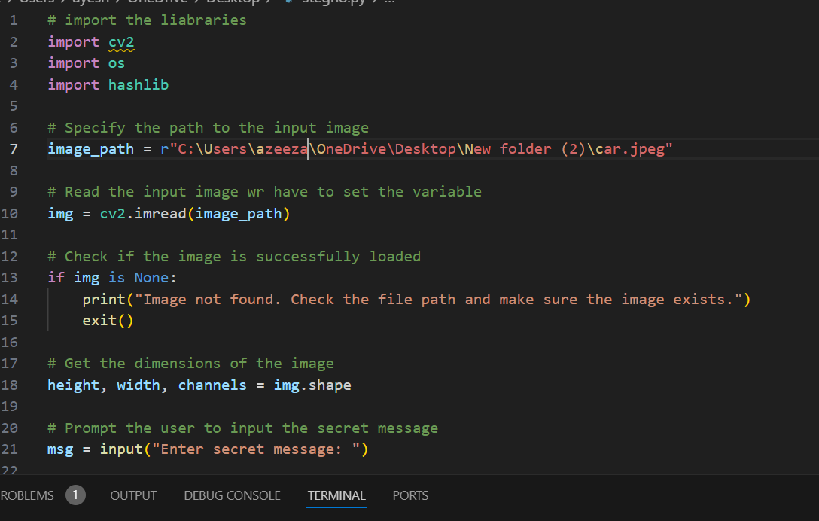
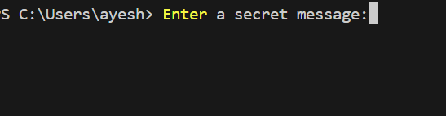
Results

Slide 10
Github repository link
https://github.com/azeezafarhanashaik/stegnography

